Slide 1
Lecture 23: Support Vector Machine (Part 2)
Instructor: Yang Xu
Slides inspired by Learning From Data (CalTech), Yaser S. Abu-Mostafa

Slide 2
Outline
Kernel method
Soft-margin SVM

Slide 3
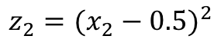
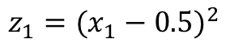
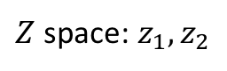
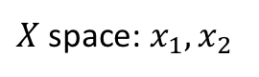
Dealing with non-linearly separable data
$X$ space: $x_{1},x_{2}$
Non-linear transform
$Z$ space: $z_{1},z_{2}$
$$z_{1}={(x_{1}−0.5)}^{2}$$
$$z_{2}={(x_{2}−0.5)}^{2}$$

Slide 4
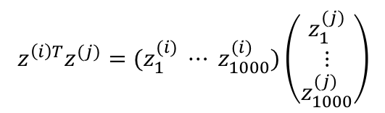
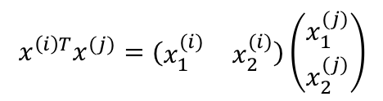
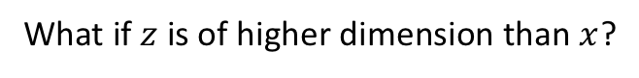
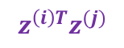
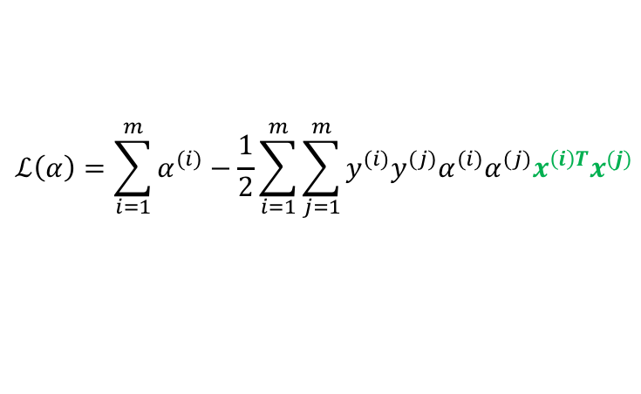

Using $z$ instead of $x$
$$ℒ\left(α\right)=\sum_{i=1}^{m}{α^{(i)}}−\frac{1}{2}\sum_{i=1}^{m}{\sum_{j=1}^{m}{y^{(i)}y^{(j)}α^{(i)}α^{(j)}x^{\left(i\right)T}x^{(j)}}}$$
Goal of SVM:
$$z^{\left(i\right)T}z^{(j)}$$
What if $z$ is of higher dimension than $x$?
X space: 2D
Z space: 1000-D
$$x^{\left(i\right)T}x^{(j)}=(\begin{matrix}x_{1}^{(i)} & x_{2}^{(i)}\end{matrix})\left(\begin{aligned}x_{1}^{(j)} \\ x_{2}^{(j)}\end{aligned}\right)$$
$$z^{\left(i\right)T}z^{(j)}=(z_{1}^{(i)} ⋯ z_{1000}^{(i)})\left(\begin{aligned}z_{1}^{(j)} \\ ⋮ \\ z_{1000}^{(j)}\end{aligned}\right)$$
Compute $m$ inner products
Number of data points $m$ does not change with dimension
Same optimization problem!

Slide 5




Support vectors in $Z$ space
Support vector lives in $Z$ space
This is the “pre-image” of SVs in $X$ space
Margin is maximized in $Z$ space, not in $X$ space

Slide 6
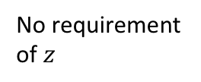
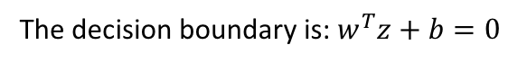
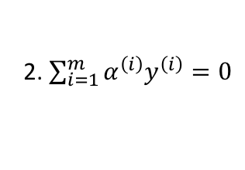
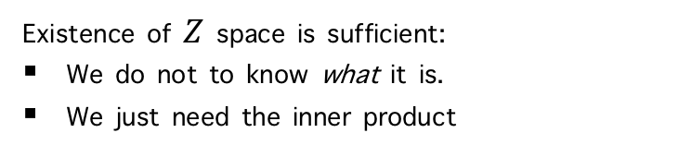

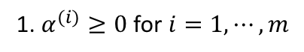
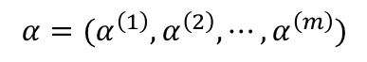
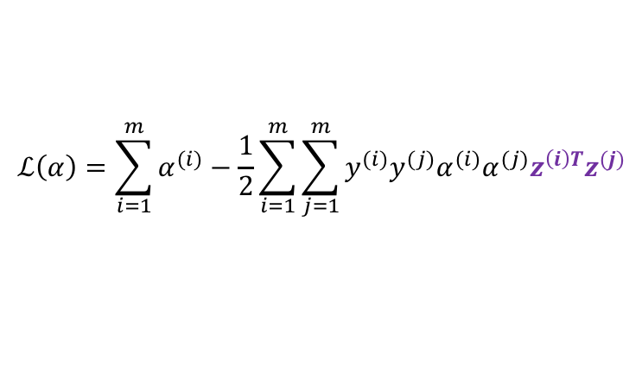
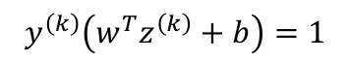
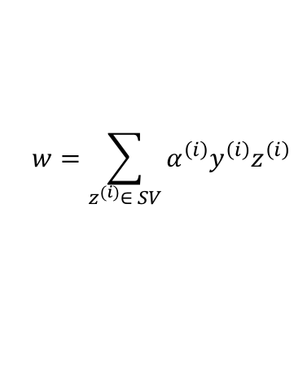
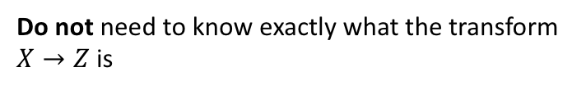
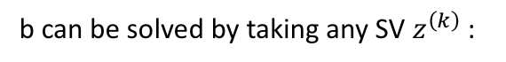
What do we need from $Z$ space?
1. $α^{(i)}≥0$ for $i=1,⋯,m$
No requirement of $z$
$$ℒ\left(α\right)=\sum_{i=1}^{m}{α^{(i)}}−\frac{1}{2}\sum_{i=1}^{m}{\sum_{j=1}^{m}{y^{(i)}y^{(j)}α^{(i)}α^{(j)}z^{\left(i\right)T}z^{(j)}}}$$
Constraints:
2. $\sum_{i=1}^{m}{α^{\left(i\right)}y^{\left(i\right)}}=0$
Solve this in $Z$ space using quadratic programming
$$α=(α^{\left(1\right)},α^{\left(2\right)},⋯,α^{\left(m\right)})$$
$$w=\sum_{z^{(i)}∈ SV}{α^{\left(i\right)}y^{\left(i\right)}z^{\left(i\right)}}$$
Only need to know $z^{\left(i\right)T}z^{\left(k\right)}$, i.e., inner product
Do not need to know exactly what the transform $X→Z$ is
b can be solved by taking any SV $z^{\left(k\right)}$:
$$y^{\left(k\right)}\left(w^{T}z^{\left(k\right)}+b\right)=1$$
Existence of $Z$ space is sufficient:
We do not to know what it is.
We just need the inner product
The decision boundary is: $w^{T}z+b=0$

Slide 7
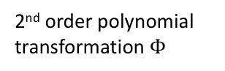
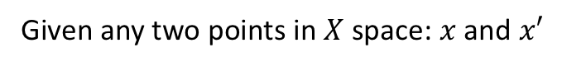
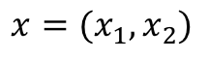
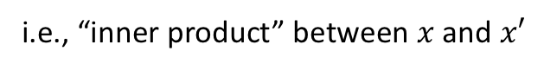
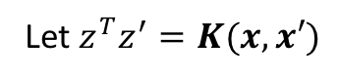
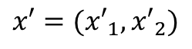
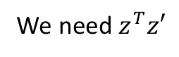
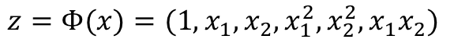
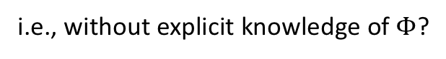
Generalized inner product
Given any two points in $X$ space: $x$ and $x′$
We need $z^{T}z′$
Let $z^{T}z^{′}=K(x,x′)$
Kernel
i.e., “inner product” between $x$ and $x′$
Example:
2nd order polynomial transformation $Φ$
$$x=(x_{1},x_{2})$$
$$z=Φ(x)=(1,x_{1},x_{2},x_{1}^{2},x_{2}^{2},x_{1}x_{2})$$
$$x′=({x′}_{1},{x′}_{2})$$
$$z′=Φ(x)=(1,{x′}_{1},{x′}_{2},{x′}_{1}^{2},{x′}_{2}^{2},{x′}_{1}{x′}_{2})$$
$$K\left(x,x^{′}\right)=z^{T}z^{′}=1+x_{1}{x′}_{1}+x_{2}{x′}_{2}+x_{1}^{2}{x′}_{1}^{2}+x_{2}^{2}{x′}_{2}^{2}+x_{1}x_{2}{x′}_{1}{x′}_{2}$$
Can we compute $K\left(x,x^{′}\right)$ without transforming $x$ and $x^{′}$,
i.e., without explicit knowledge of $Φ$?

Slide 8
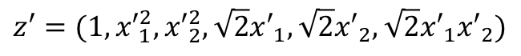
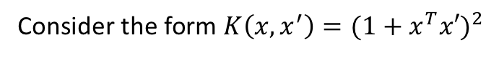
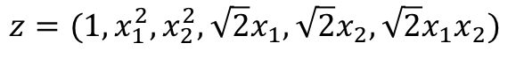
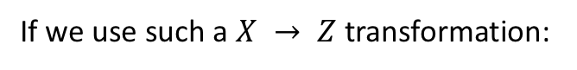
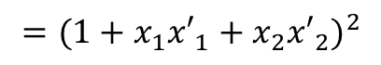
Generalized inner product (cont.)
It’s just a function, not inner product in X space
Consider the form $K\left(x,x^{′}\right)={(1+x^{T}x′)}^{2}$
We don’t know if it is the inner product in any other space
$$={(1+x_{1}{x′}_{1}+x_{2}{x′}_{2})}^{2}$$
$$=1+x_{1}^{2}{x′}_{1}^{2}+x_{2}^{2}{x′}_{2}^{2}+2x_{1}{x′}_{1}+2x_{2}{x′}_{2}+2x_{1}x_{2}{x′}_{1}{x′}_{2}$$
This is still an inner product
If we use such a $X → Z$transformation:
$$z=(1,x_{1}^{2},x_{2}^{2},\sqrt{2}x_{1},\sqrt{2}x_{2},\sqrt{2}x_{1}x_{2})$$
$$z′=(1,{x′}_{1}^{2},{x′}_{2}^{2},\sqrt{2}{x′}_{1},\sqrt{2}{x′}_{2},\sqrt{2}{x′}_{1}{x′}_{2})$$
Kernel becomes handy when raising to higher order space

Slide 9
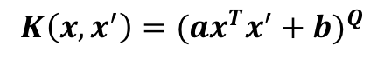
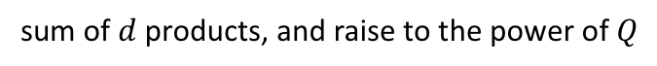
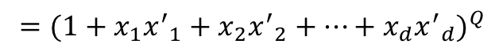
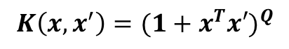
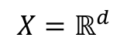
Polynomial kernel
$$X=ℝ^{d}$$
$Φ:X→Z$ is a polynomial transformation of order $Q$
The equivalent kernel is:
$$K\left(x,x^{′}\right)={(1+x^{T}x′)}^{Q}$$
$$={(1+x_{1}{x^{′}}_{1}+x_{2}{x^{′}}_{2}+⋯+x_{d}{x^{′}}_{d})}^{Q}$$
This is a rather simple computation:
sum of $d$ products, and raise to the power of $Q$
Don’t need to actually expand the polynomial
Scales can be adjusted:
$$K\left(x,x^{′}\right)={(ax^{T}x^{′}+b)}^{Q}$$

Slide 10
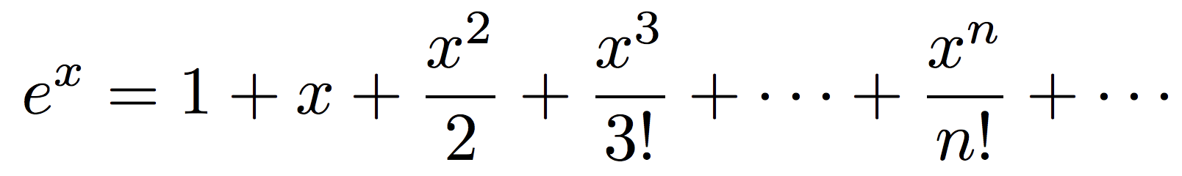
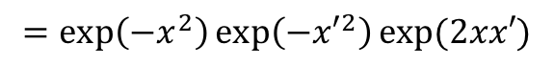
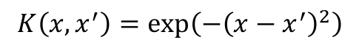
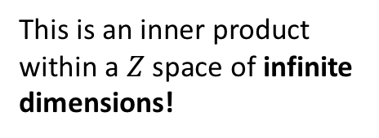
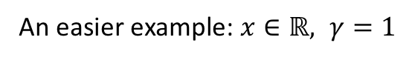
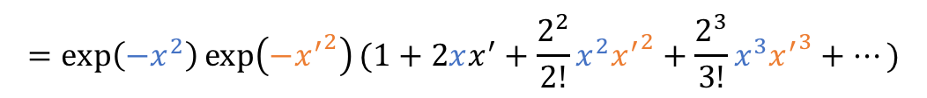
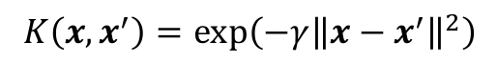
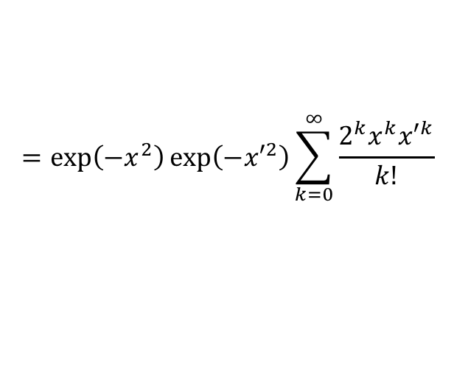
Even less knowledge about $Z$ space
We only need $Z$ to exist. Don’t need to know what $Z$ is.
Radius basis function (RBF) kernel:
$$K\left(x,x^{′}\right)=\exp\left(−γ{\left\|x−x^{′}\right\|}^{2}\right)$$
Is this an inner product in some space?
An easier example: $x∈ℝ, γ=1$
Tayler expansion:
$$K\left(x,x^{′}\right)=\exp\left(−{\left(x−x^{′}\right)}^{2}\right)$$
$$=\exp\left(−x^{2}\right)\exp\left(−{x′}^{2}\right)exp⁡(2xx′)$$
$$=\exp\left(−x^{2}\right)\exp\left(−{x′}^{2}\right)\sum_{k=0}^{∞}{\frac{2^{k}x^{k}{x′}^{k}}{k!}}$$
This is an inner product within a $Z$ space of infinite dimensions!
$$=\exp\left(−x^{2}\right)\exp\left(−{x^{′}}^{2}\right)(1+2xx^{′}+\frac{2^{2}}{2!}x^{2}{x^{′}}^{2}+\frac{2^{3}}{3!}x^{3}{x^{′}}^{3}+⋯)$$

Slide 11
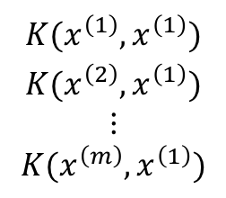
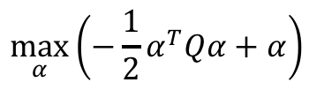
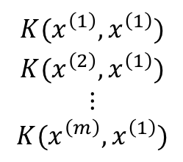



Kernel formulation of SVM
Quadratic programming:
$$\max_{α}\left(−\frac{1}{2}α^{T}Qα+α\right)$$
Subject to:
$$y^{T}α=0;α>0$$
$$\begin{aligned}K(x^{\left(1\right)},x^{\left(1\right)}) \\ K(x^{\left(2\right)},x^{\left(1\right)}) \\ ⋮ \\ K(x^{\left(m\right)},x^{\left(1\right)})\end{aligned}$$
$$\begin{aligned}K(x^{\left(1\right)},x^{\left(1\right)}) \\ K(x^{\left(2\right)},x^{\left(1\right)}) \\ ⋮ \\ K(x^{\left(m\right)},x^{\left(1\right)})\end{aligned}$$
$$Q=\left[\begin{aligned}y^{(1)}y^{(1)}x^{\left(1\right)T}x^{(1)} \\ y^{(2)}y^{(1)}x^{\left(2\right)T}x^{(1)} \\ ⋮ \\ y^{(m)}y^{(1)}x^{\left(m\right)T}x^{(1)}\end{aligned}\begin{matrix} \\ \\ \end{matrix}\begin{matrix} \\ \\ \end{matrix}\begin{aligned}y^{(1)}y^{(2)}x^{\left(1\right)T}x^{(2)} \\ y^{(2)}y^{(2)}x^{\left(2\right)T}x^{(2)} \\ ⋮ \\ y^{(m)}y^{(2)}x^{\left(m\right)T}x^{(2)}\end{aligned}\begin{matrix} \\ \\ \end{matrix}\begin{matrix} \\ \\ \end{matrix}\begin{aligned}⋯ \\ ⋯ \\ ⋯ \\ ⋯\end{aligned}\begin{matrix} \\ \\ \end{matrix}\begin{matrix} \\ \\ \end{matrix}\begin{aligned}y^{(1)}y^{(m)}x^{\left(1\right)T}x^{(m)} \\ y^{(2)}y^{(m)}x^{\left(2\right)T}x^{(m)} \\ ⋮ \\ y^{(m)}y^{(m)}x^{\left(m\right)T}x^{(m)}\end{aligned}\begin{matrix} \\ \\ \end{matrix}\begin{matrix} \\ \\ \end{matrix}\right]$$
$$\begin{aligned}K(x^{\left(1\right)},x^{\left(1\right)}) \\ K(x^{\left(2\right)},x^{\left(1\right)}) \\ ⋮ \\ K(x^{\left(m\right)},x^{\left(1\right)})\end{aligned}$$
Everything else is the same!

Slide 12






Kernel formulation of SVM (cont.)
$$w=\sum_{z^{(i)}∈ SV}{α^{\left(i\right)}y^{\left(i\right)}z^{\left(i\right)}}$$
Solution from QP:
Inner product is defined by the kernel function
$$\sum_{α^{(i)}>0}{α^{\left(i\right)}y^{\left(i\right)}K(x^{(i)},x)}+b=0$$
Decision boundary:
$w^{T}z+b=0$
where
$$b=y^{(k)}−\sum_{α^{(i)}>0}{α^{\left(i\right)}y^{\left(i\right)}K(x^{(i)},x^{(k)})}$$
for any support vector ($α^{\left(k\right)}>0$)
$$sign\left(\sum_{α^{(i)}>0}{α^{\left(i\right)}y^{\left(i\right)}K(x^{(i)},x)}+b\right)$$
The model is:

Slide 13
Dealing with non-linearly separable data
Kernel method works for horribly non-separable data
Sometimes we can use a soft margin that is more tolerant to mistakes

Slide 14
Two types of non-separable data
Slightly
Seriously
Soft-margin deals with this
Combine
Kernels deal with this

Slide 15







Violation of margin
For SVs:
$$y^{\left(i\right)}\left(w^{T}x^{\left(i\right)}+b\right)=1$$
For any points outside the margin:
$$y^{\left(i\right)}\left(w^{T}x^{\left(i\right)}+b\right)>1$$
Allow violations:
$$0<y^{\left(i\right)}\left(w^{T}x^{\left(i\right)}+b\right)<1$$
Violate margin
$$y^{\left(i\right)}\left(w^{T}x^{\left(i\right)}+b\right)<0$$
Misclassified
violation
Use a slack to measure the violation:
$$y^{\left(i\right)}\left(w^{T}x^{\left(i\right)}+b\right)≥1−ξ^{(i)}$$
$$ξ^{(i)}≥0$$
$$=\sum_{i=1}^{m}{ξ^{(i)}}$$
Penalize the total violation:
Change the optimization goal by including this error term

Slide 16








New optimization goal
$$+C\sum_{i=1}^{m}{ξ^{(i)}}$$
Minimize:
$$\frac{1}{2}w^{T}w$$
Subject to
$y^{\left(i\right)}\left(w^{T}x^{\left(i\right)}+b\right)≥1−ξ^{(i)}$, for $i=1,⋯,m$
and $ξ^{(i)}≥0$, for $i=1,⋯,m$
If $C$ is big:
Constant $C$ quantifies the relative importance of avoiding violations
or tolerance to violations
$w$ will be learned in a way that only small $ξ^{(i)}$ are allowed
If $C$ is small:
$w$ will be learned in a way that big $ξ^{(i)}$ are allowed

Slide 17









New Lagrangian
$$ℒ\left(w,b,ξ,α,β\right)=\frac{1}{2}w^{T}w+C\sum_{i=1}^{m}{ξ^{(i)}}−\sum_{i=1}^{m}{α^{\left(i\right)}\left(y^{\left(i\right)}\left(w^{T}x^{\left(i\right)}+b\right)−1+ξ^{\left(i\right)}\right)}−\sum_{i=1}^{m}{β^{\left(i\right)}ξ^{(i)}}$$
Minimize w.r.t. $w$, $b$, and $ξ$
and maximize w.r.t. each $α^{(i)}≥0$ and $β^{(i)}≥0$
$$\frac{∂ℒ}{∂w}=w−\sum_{i=1}^{m}{α^{\left(i\right)}y^{\left(i\right)}x^{\left(i\right)}}=0$$
Exactly the same Lagrangian ℒ(𝜶)!
Same form as before
$$\frac{∂ℒ}{∂b}=−\sum_{i=1}^{m}{α^{\left(i\right)}y^{\left(i\right)}}=0$$
With only one additional constraint:
$$C≥α^{(i)}≥0$$
because $β^{(i)}≥0$
$$\frac{∂ℒ}{∂ξ^{(i)}}$$
$$=C−α^{\left(i\right)}−β^{\left(i\right)}=0$$
for $i=1,⋯,m$

Slide 18






Solution
$$ℒ\left(α\right)=\sum_{i=1}^{m}{α^{(i)}}−\frac{1}{2}\sum_{i=1}^{m}{\sum_{j=1}^{m}{y^{(i)}y^{(j)}α^{(i)}α^{(j)}x^{\left(i\right)T}x^{(j)}}}$$
Maximize:
Subject to $C≥α^{(i)}≥0$ for $i=1,⋯,m$
and $\sum_{i=1}^{m}{α^{\left(i\right)}y^{\left(i\right)}}=0$
$$w=\sum_{i=1}^{m}{α^{\left(i\right)}y^{\left(i\right)}x^{\left(i\right)}}$$
Quadratic programming
$$\frac{1}{2}w^{T}w$$
$$+C\sum_{i=1}^{m}{ξ^{(i)}}$$
which minimizes

Slide 19










Types of support vectors
Strictly greater than
Margin support vectors: $C>α^{\left(i\right)}>0$
$$y^{\left(i\right)}\left(w^{T}x^{\left(i\right)}+b\right)=1$$
$$ξ^{(i)}=0$$
$$β^{\left(i\right)}>0$$
Non-margin support vectors: $α^{\left(i\right)}=C$
$$y^{\left(i\right)}\left(w^{T}x^{\left(i\right)}+b\right)<1$$
$$ξ^{(i)}>0$$
$$β^{\left(i\right)}=0$$
Violate the margin, but correctly classified
$$0<y^{\left(i\right)}\left(w^{T}x^{\left(i\right)}+b\right)<1$$
Violate the margin, and misclassified
$$y^{\left(i\right)}\left(w^{T}x^{\left(i\right)}+b\right)<0$$

Slide 20



Choose proper hyperparameters
Soft margin is usually the default
Choose $C∈\{2^{−4},2^{−3},⋯,2^{4}\}$
Best $C$ can be determined by cross-validation
Combined with kernel methods
E.g., RBF kernel
$$K\left(x,x^{′}\right)=\exp\left(−γ{\left\|x−x^{′}\right\|}^{2}\right)$$
Choose best $C$ and $γ$ using grid search: $C,γ∈\{2^{−4},2^{−3},⋯,2^{4}\}$

Slide 21






Recap of SVM
$$\frac{1}{2}w^{T}w$$
$ℒ\left(w,b, α\right)$ → $ℒ\left(α\right)=−\frac{1}{2}α^{T}Qα+α$
Maximize the margin → minimize
Use Kernel to replace the inner product $x^{T}x′$ in $Q$ with $K\left(x,x^{′}\right)$
Soft margin → minimize
$$\max_{α}\left(−\frac{1}{2}α^{T}Qα+α\right)$$
solve $α$ with QP, get $w$
$$\frac{1}{2}w^{T}w+C\sum_{i=1}^{m}{ξ^{(i)}}$$

